Slide 1
Economic Snapshot of Women in Nevada

Slide 2
Topics
Demographic Statistics
Race and ethnicity • Foreign born • Total population
Workforce Characteristics
Women and the minimum wage • Women, families, and poverty
Economic Status of Nevada Women
Gender wage gap over time • Gender wage gap by Congressional district • Earnings by educational attainment • Occupational distribution • Median earnings by occupation • Unemployment rate • Median earnings by race/ethnicity • Nevada industries • Small business profile
Status of Paid Leave and Childcare in Nevada

Slide 3
Demographic statistics

Slide 4
Demographic Statistics
Total Population: 2,890,845
Number of women and girls, All Ages: 1,442,531 (49.9% of total population)
Proportion of Women Aged 65 and Older: 15.4%
Proportion of Women Who Are Immigrants, All Ages: 20.4%
Percent of Households Headed by Single Mothers with Children Under Age 18: 7.2%
Foreign born in Nevada – 558,170
Source: U.S. Census Bureau, Selected Population Profile in the United States, 2015 American Community Survey, 1-Year Estimates
Notes:
Foreign born data is not disaggregated by gender as collected by the Census.

Slide 5
Race and Ethnicity
Source: U.S. Census Bureau, Selected Population Profile in the United States, 2015 American Community Survey, 1-Year Estimates

Slide 6
Workforce characteristics

Slide 7
Workforce Characteristics
58.2% of all Nevada women participating in labor force.
7.7% unemployment rate for women in Nevada
42.7% of working women worked full-time, year round
Women earned 84% of the men’s wages – wage gap was greater for women of color
The poverty rate of families with a single female householder with children under 5 was 35.2%
Median annual earnings for women working full-time, year-round: $36,565
Source: U.S. Census Bureau, 2015 American Community Survey 1-Year Estimates, Nevada

Slide 8
Women and the Minimum Wage
The federal minimum wage has been stuck at $7.25 an hour for 7 years.
Nevada minimum wage is at $8.25; $7.25 for employees offered health benefits by employer. ¹
According to Oxfam America, Women represent nearly 2/3rds of minimum wage workers across the country and in Nevada, they represent more than half of all minimum wage workers. ²
In Nevada, 30.3% of all workers earn less than $12 an hour (Oxfam America).
Nearly half of Nevada minimum wage workers have no paid sick leave (49%) (Oxfam America).
National Women’s Law Center
Oxfam America, Economic Policy Institute
Notes:
“Women, The Minimum Wage, and the Wage Gap, State by State.” National Women’s Law Center. Accessed November 1, 2016. https://nwlc.org/wp-content/uploads/2015/08/women_the_minimum_wage_and_the_wage_gap_state_by_state_8.11.15.pdf
“Oxfam minimum wage state scorecard.” Oxfam America, Economic Policy Institute. Accessed November 1, 2016. https://policy-practice.oxfamamerica.org/work/poverty-in-the-us/low-wage-map/scorecard/?state=NV

Slide 9
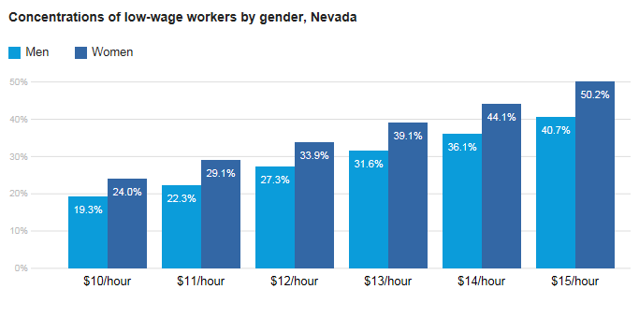
Oxfam Study Finds Women are the Majority of Low-Wage Workers
Notes:
“Oxfam minimum wage state scorecard.” Oxfam America, Economic Policy Institute. Accessed November 1, 2016. https://policy-practice.oxfamamerica.org/work/poverty-in-the-us/low-wage-map/scorecard/?state=NV

Slide 10
Women and Families Profile
Of the 21 percent of households headed by women,
54 percent have children under the age of 18 living in their homes and
9 percent have children under the age of 6.
Source: U.S. Census Bureau, 2015 American Community Survey 1-Year Estimates, Nevada

Slide 11
Families headed by Women Raising Children by Age of Children
11 percent of families live below the poverty line – 51 percent are headed by women.
Of those households headed by women, 84 percent have related children under the age of 18.
Among these families, 60 percent are public school age, 13 percent are newborn to preschool age, and 27 percent are a mix between the two.
Notes:
11 percent of families live below the poverty line – 51 percent are headed by women. Of those households headed by women, 84 percent have related children under the age of 18. Among these families, 60 percent are public school age, 13 percent are newborn to preschool age, and 27 percent are a mix between the two.

Slide 12
Economic status of women in Nevada

Slide 13
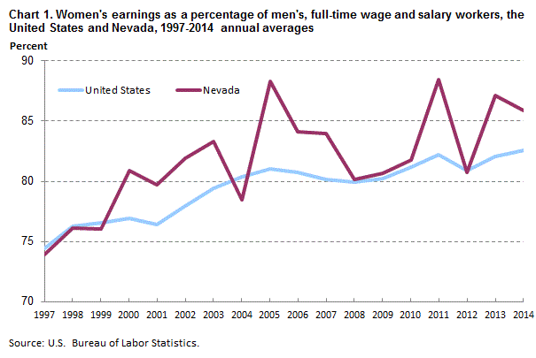
Notes:
http://www.bls.gov/regions/west/news-release/womensearnings_nevada.htm

Slide 14
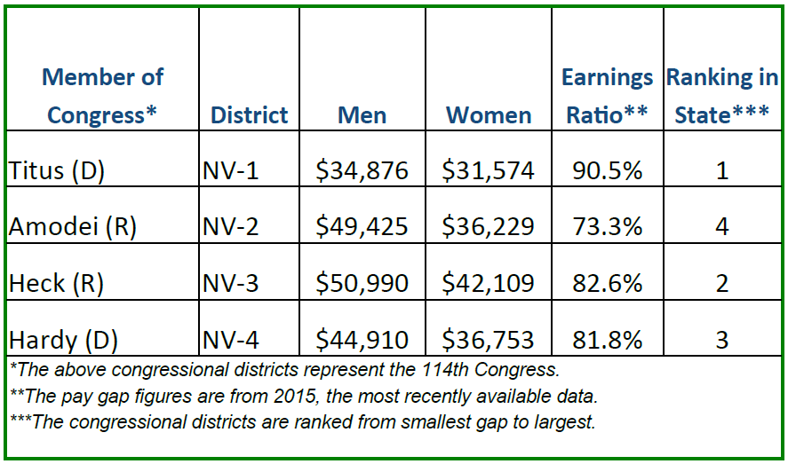
AAUW Gender Wage Gap by Nevada Congressional District
Source: American Association of University Women
Notes:
“The Gender Pay Gap b State and Congressional District.” American Association of University Women. Accessed November 1, 2016. http://www.aauw.org/files/2016/09/Nevada-Pay-Gap-2016.pdf
Many of the nonprofit women’s organizations are tracking the pay gap by state and even congressional district. AAUW has provided a ranking of the wage gap by congressional districts.
Congressional District 1– Las Vegas, Winchester, Paradise
Congressional District 2 – Winnemucca, Lovelock, Elko, Carlin
Congressional District 3 – Boulder City, Henderson, Enterprise
Congressional District 4 – Pioche, Goldfield, Pahrump, Moapa Valley

Slide 15
Median Earnings by Educational Attainment and Sex, 2015
Source: U.S. Census Bureau, 2015 American Community Survey 1-Year Estimates, Nevada

Slide 16
Nevada Men’s and Women’s Occupational Distribution, 2015
Source: U.S. Census Bureau, 2015 American Community Survey 1-Year Estimates, Nevada

Slide 17
Median Earnings by Occupational Categories and Sex, 2015
Source: U.S. Census Bureau, 2015 American Community Survey 1-Year Estimates, Nevada

Slide 18
Unemployment Rate, 2016
Source: U.S. Bureau of Labor Statistics.
Notes:
Unemployment Rates for States Annual Average Rankings – ranked 59.
Nevada – 6.7 unemployment rate
http://www.bls.gov/lau/lastrk15.htm
Nevada unemployment rate higher than US.

Slide 19
Unemployment Rate for Nevada Men and Women, 2015
Source: U.S. Census Bureau, 2015 American Community Survey 1-Year Estimates, Nevada

Slide 20
Median Earnings by Race/Ethnicity and Sex, 2015
Source: U.S. Census Bureau, 2015 American Community Survey 1-Year Estimates, Nevada
Notes:
MEDIAN EARNINGS IN THE PAST 12 MONTHS (IN 2015 INFLATION-ADJUSTED DOLLARS) BY SEX BY WORK EXPERIENCE IN THE PAST 12 MONTHS FOR THE POPULATION 16 YEARS AND OVER WITH EARNINGS IN THE PAST 12 MONTHS
Wage Gap by Race
African American or Black Women – 68%
Hispanic or Latina Women – 58%
Asian Women – 73%
White Women – 80%
Wage Gap in Nevada – women earn 84 cents for every dollar their male counterparts earn.
Wages are so low

Slide 21
Nevada’s Largest Industries & Employers
Industries
Major Employers
Tourism and Gaming
Logistics
Manufacturing
Mining
Aerospace & Defense
Agriculture
Energy
Health Care
Information Technology
Wynn Las Vegas LLC
Venetian Resort Hotel & Casino
Las Vegas Sands Corp
US Air Force Base
Liberty Tax Services
Source: Nevada Governor’s Office of Economic Development
Notes:
Tourism, Gaming, & Hospitality:
Nevada’s largest industry sector employs 413,000 workers who make, on average, $32,100 per year.
Logistics & Operations
This sector employs roughly 70,100 workers who make, on average, $57,900 per year.
Nevada continues to focus its efforts on this industry and has plans to turn the state into a warehouse distribution hub (i.e. Amazon, Levi Strauss $ Co., Toys R Us).
Manufacturing
Nevada’s manufacturing sector employs 42,000 workers who make an average annual wage of $56,700.
Mining
Roughly 13,100 workers are employed in the sector making, on average, $90,400 per year.
Aerospace & Defense
Roughly 12,840 Nevadans work in this sector and earn on average $81,143
Agriculture
There are currently 7,700 workers employed in the sector making an average annual wage of $37,900.
Energy
Currently, the sector represents 25,600 jobs that pay an average annual wage of $63,900.
Health Care
Over 53,000 workers are in the health care sector. Annual earnings grew by a slightly faster rate bringing average pay to $53,500 per year for workers.
Information Technology
There are currently 55,300 workers in Nevada’s Business Information Technology. Earnings, improved by $400 per year bringing average annual earnings up to $47,400.
Employers
Wynn Las Vegas LLC – 12K employees
Venetian Resort Hotel & Casino – 10K employees
Las Vegas Sands Corp – 9,500 employees
US Air Force Base – 9,185 employees
Liberty Tax Services – 6,000 employees
Source: http://www.diversifynevada.com/key-industries

Slide 22
Companies Doing Business in Nevada
Source: Nevada Governor’s Office of Economic Development

Slide 23
Status of Paid Leave and Child Care in US and Nevada

Slide 24
What do we know about family leave on a national level?
US is the only industrialized nation without a national paid leave program
12.6 percent of private-sector employees took family and medical leave in 2012 while 4.5 percent had unmet leave needs
1 in 4 employees needing leave had their leave needs unmet in the past 12 months because:
49.6 percent could not afford unpaid leave
18.3 percent feared losing their job as a result of taking leave.³
Jorgensen, H. Appelbaum, E.
Notes:
Reference: Jorgensen, H. Appelbaum, E. “Documenting the Need for a National Paid Family and Medical Leave Program: Evidence from the 2012 FMLA Survey.” Center for Economic and Policy Research, Accessed November 1, 2016. http://cepr.net/documents/fmla-paid-leave-2014-06.pdf

Slide 25
Employees with children living at home and female employees had the greatest need for leave and highest rates of unmet leave.
In March 2016, 13 percent of all private sector workers had access to paid leave.⁴
7 percent of service workers had access to leave and 13 percent of those who had leave are in the sales and office industry (BLS)
Bureau of Labor Statistics
Notes:
Bureau of Labor Statistics, U.S. Department of Labor, The Economics Daily, 13 percent of private industry workers had access to paid family leave in March 2016 on the Internet at http://www.bls.gov/opub/ted/2016/13-percent-of-private-industry-workers-had-access-to-paid-family-leave-in-march-2016.htm (visited December 01, 2016).

Slide 26
What do we know about family leave in Nevada?
Nevada does not significantly expand upon federal law for state employees or private-sector workers.
49 percent of workers do not have access to paid sick days according to a study by the National Partnership for Women and families and the Institute for Women’s Policy and Research, a higher rate than the national average of 12.5 percent.⁵
37 percent of workers work for an employer with less than 50 employees.⁶
Lack of data available to indicate the number of Nevada employees, specifically women who are covered under FMLA
National Partnership for Women and Families
U.S. Census Bureau, American Community Survey, 2014
Notes:
“Workers’ Access to Paid Sick Days in the States.” National Partnership for Women in Families, Institute for Women’s Policy Research. Accessed November 1, 2016 http://www.nationalpartnership.org/research-library/work-family/psd/workers-access-to-paid-sick-days-in-the-states.pdf.
U.S. Census Bureau, American Community Survey, 2014. CB1400A13: Geography Area Series: County Business Patterns by Employment Size Class. Accessed on November 1, 2016. http://factfinder.census.gov/faces/tableservices/jsf/pages/productview.xhtml?pid=BP_2014_00A3&prodType=table

Slide 27
What do we know about childcare in Nevada?
Parents working full-time, child care costs would be 37% of household income
Cost of childcare is high and even more than in-state college tuition
$27,147 for in-home and $9,724 for in-center ⁷
Infant care costs as a share of minimum wage earnings is 57.4%
$9,852 for annual infant care costs ⁸
New America
Economic Policy Institute
Notes:
Durana, A., Schulte, B. (2015). “In Depth: the Care Report.” New America. Accessed on November 1, 2016. https://www.newamerica.org/in-depth/care-report/
Economic Policy Institute. “How Does Your State Stack Up? Annual Infant Care Costs in Nevada”. Accessed November 1, 2016. http://www.newamerica.org/in-depth/care-report/explore-care-index/.

Slide 28
Infant care costs as a share of public college tuition Is 195.9%
Average in-state tuition for 4-year public college is $5,029 (i.e. UNLV is $5,760)
Nevada has 221,494 children under age 6, 65 percent of whom have working parents⁹
Child Care and Development Block Grant (CCDBG) serves only 6 percent of federally eligible children in Nevada¹⁰
U.S. Census Bureau
Center for American Progress
Notes:
US Census Bureau, “Current Population Survey, Annual Social and Economic Supplement, 2015.” Accessed November 1, 2016. http:// www.census.gov/cps/data/cpstablecreator.html April 2016)
Troe, J. “Early Learning in Nevada.” Center for American Progress. Accessed November 1, 2016. https://cdn.americanprogress.org/wp-content/uploads/2016/07/13123314/EC-factsheets_NV.pdf

